Slide 1

End of studies project
Automatic Speech Recognition in the field of healthcare
Meribout Ahmed Yahia Zouak Omar Elfarouk

Slide 2
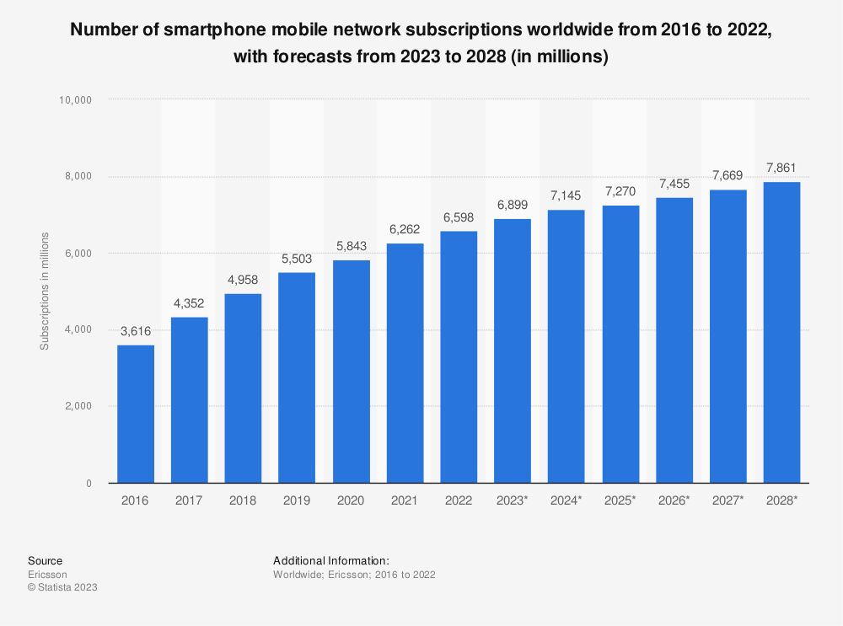
Smartphones are Increasing in popularity more popular than ever before

Slide 3

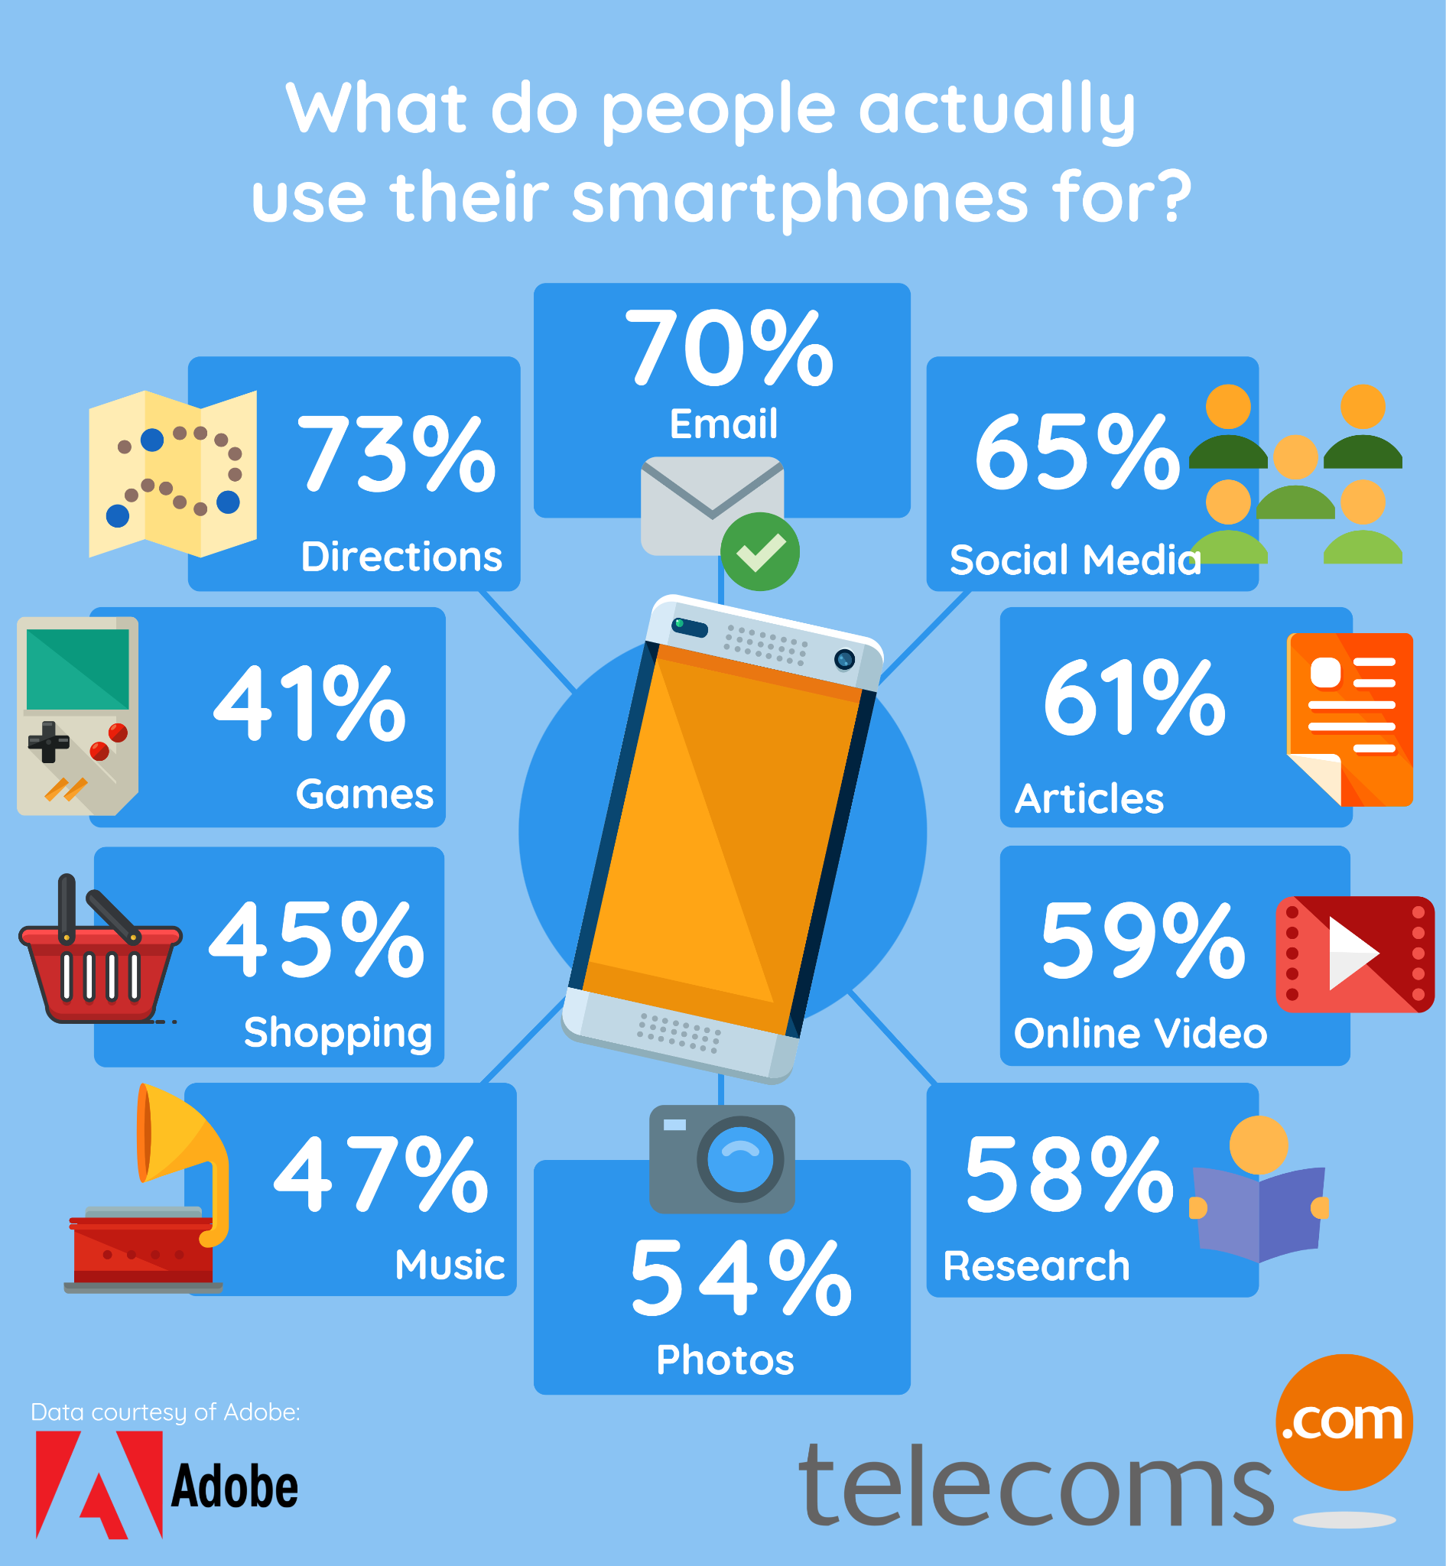
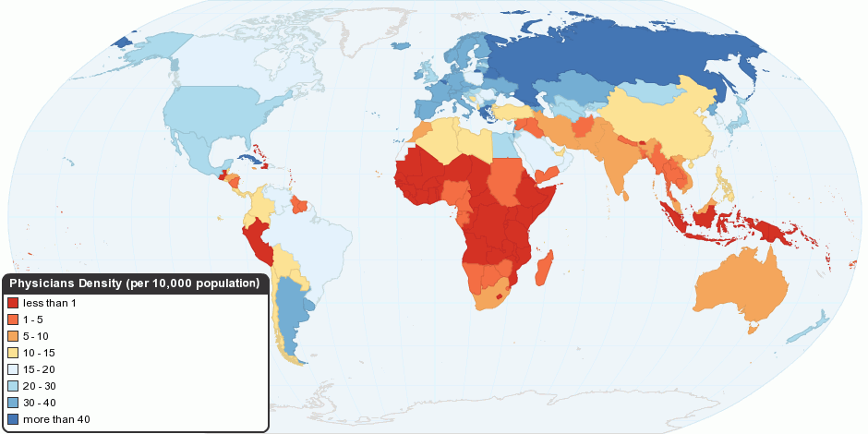
Use of smart phones:

Slide 4
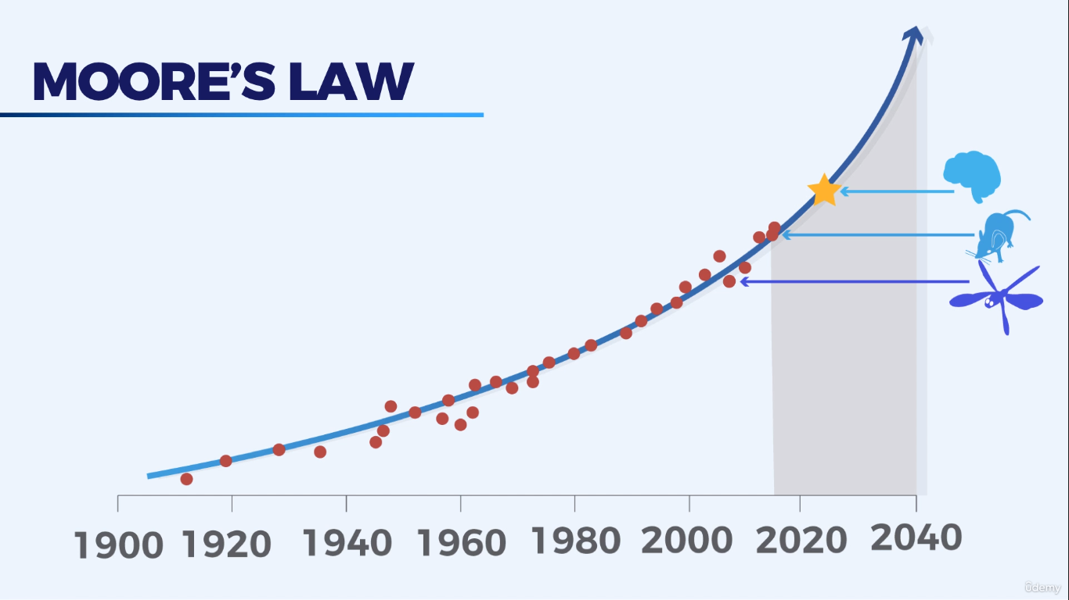

Slide 5




What an healthcare app can provide
Receive immediate access to healthcare.
Easily track users’ health.
Improve treatment process.
Reduce costs for medical services.
Help prevent legal issues

Slide 6
We attempted to make a healthcare app that uses speech recognition to diagnose patients and here is a summary for everything:

Slide 7
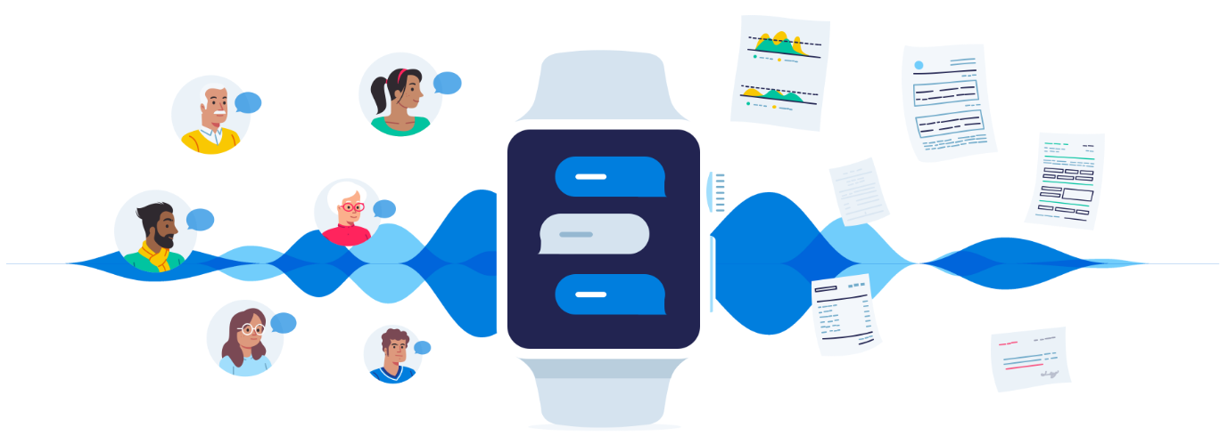
ASR in healthcare:
Healthcare can be greatly aided by voice recognition.patients can benefit from this technology since it makes it easier than ever before to seek help if they are feeling unwell using an app on their phones where voice-dictation software will transcribe their words so someone else can read it back and see if anything needs to be addressed or an virtual assistant that can give treatment for small common illness like cold and basic headache and redirect patients to nearby doctors if necessary.In addition Asr helps the patient to express himself more in front of the device he is using

Slide 8







Tools used for the application

Slide 9
Final results:
After going through the consumption phase,and the development of the app we came up with a solution that is well rounded and ready for deployment in the real world and be accessible to the public and fulfil the goals that we anticipated.

Slide 10
Patient App Interfaces:

Slide 11
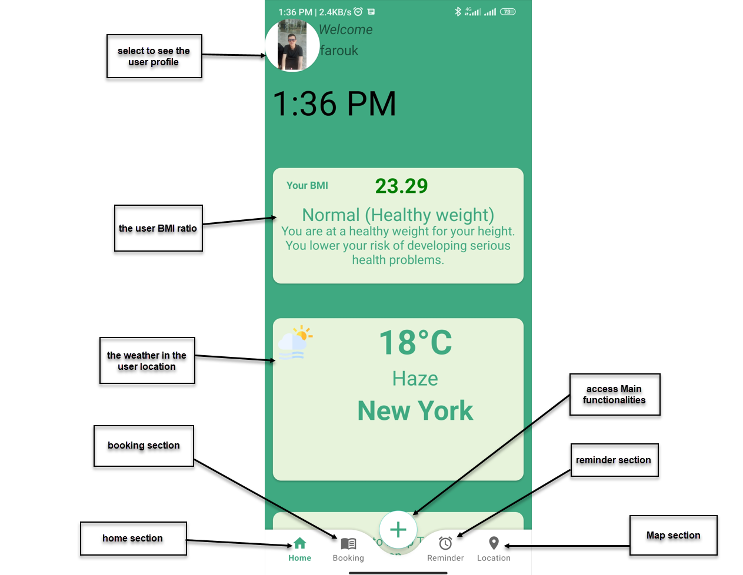
Main Page

Slide 12
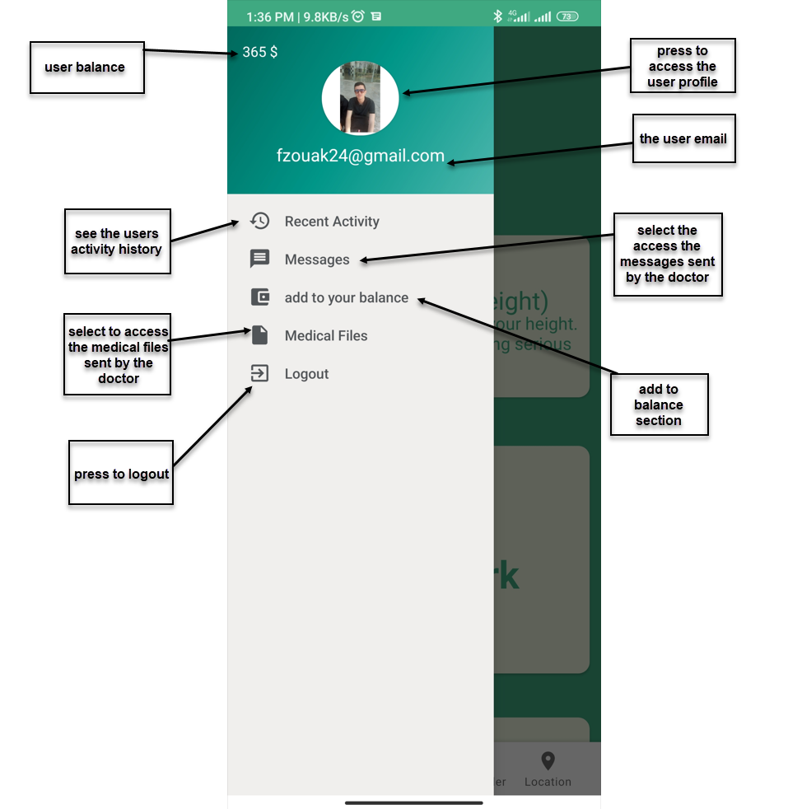
Side Bar

Slide 13
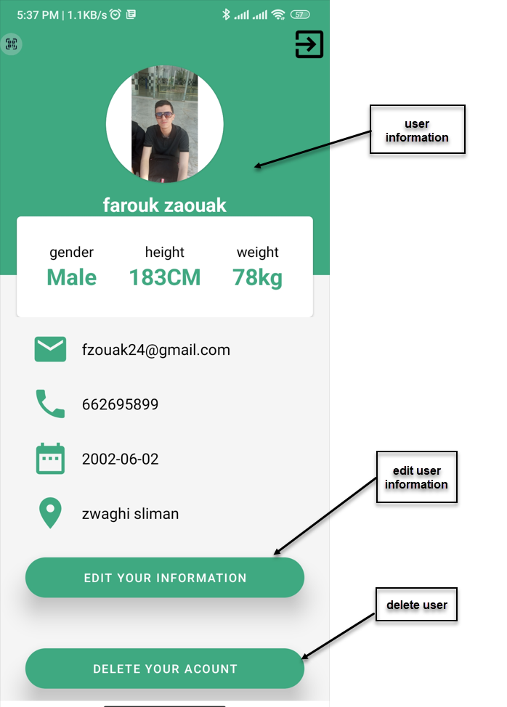
Profile page

Slide 14
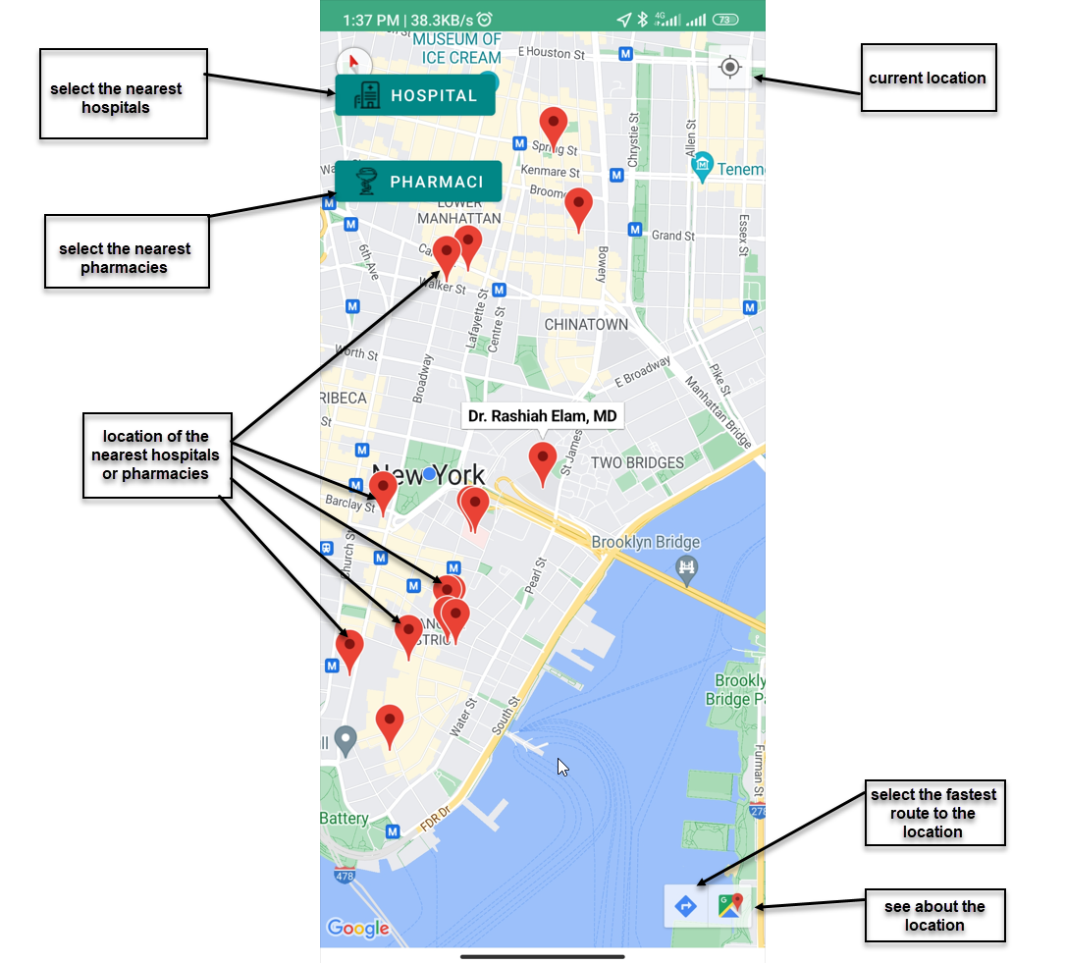
Map

Slide 15
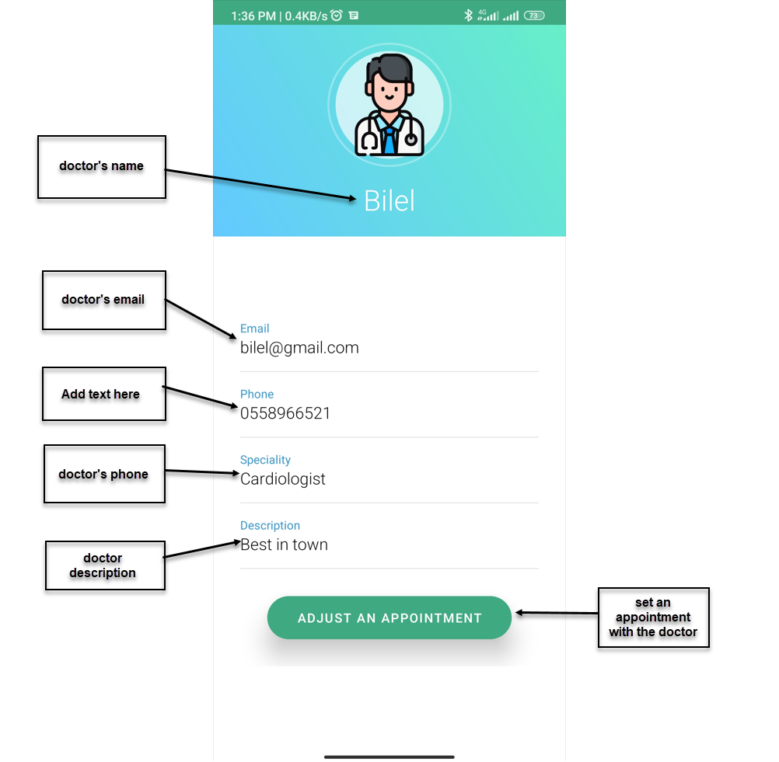
Doctor Profile Page

Slide 16
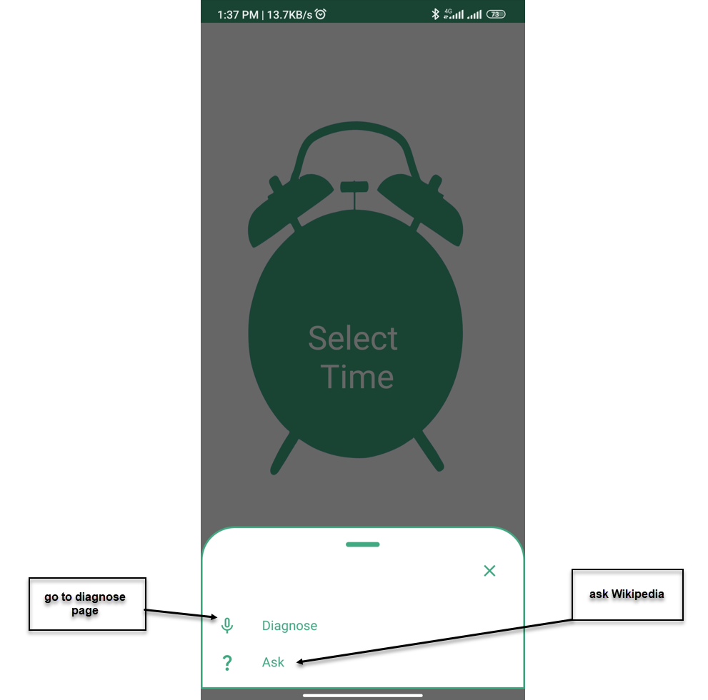
Bottom Bar

Slide 17
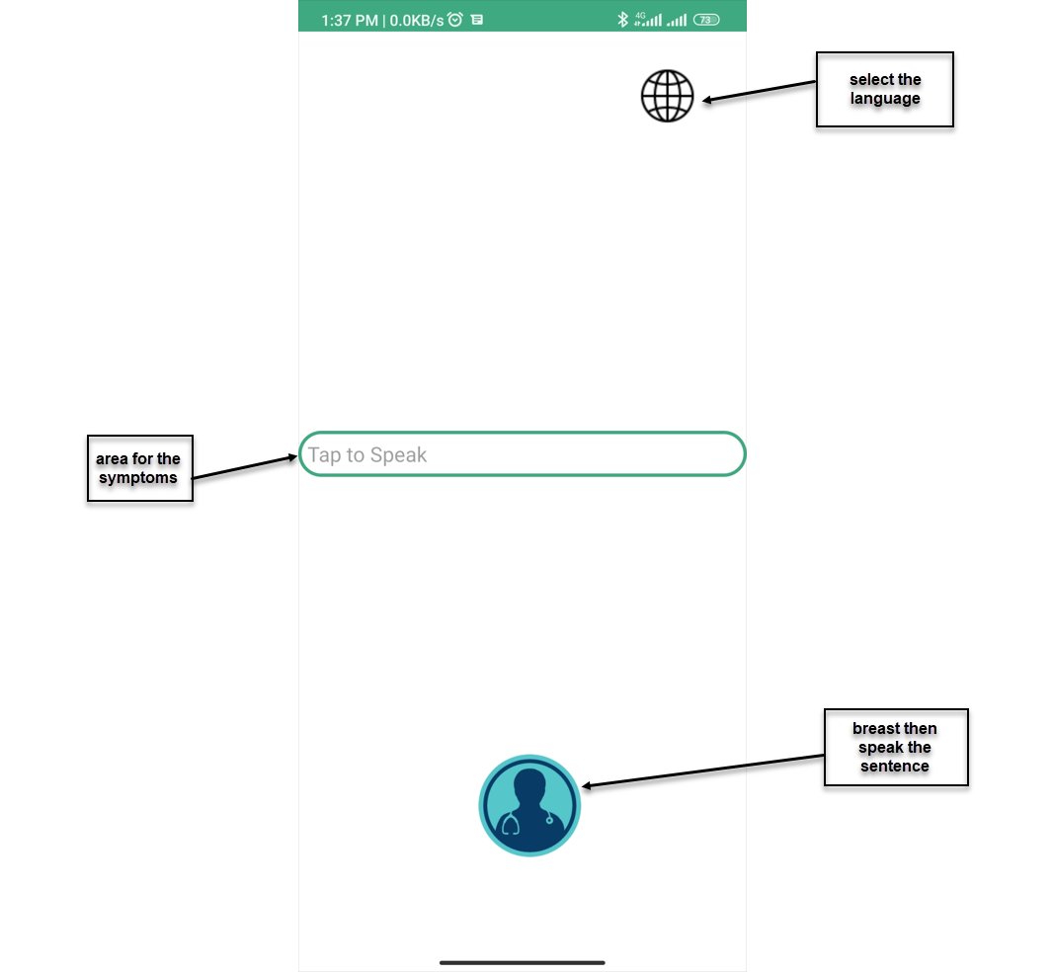
Diagnose Activity

Slide 18
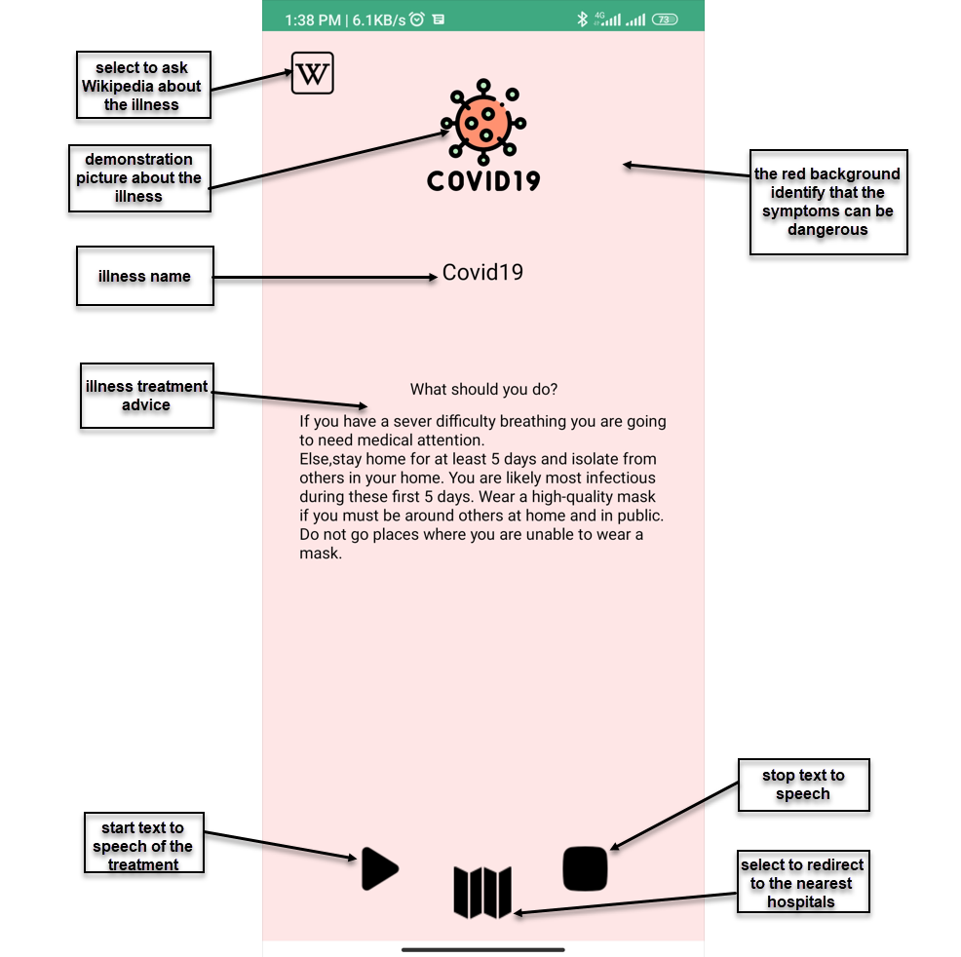
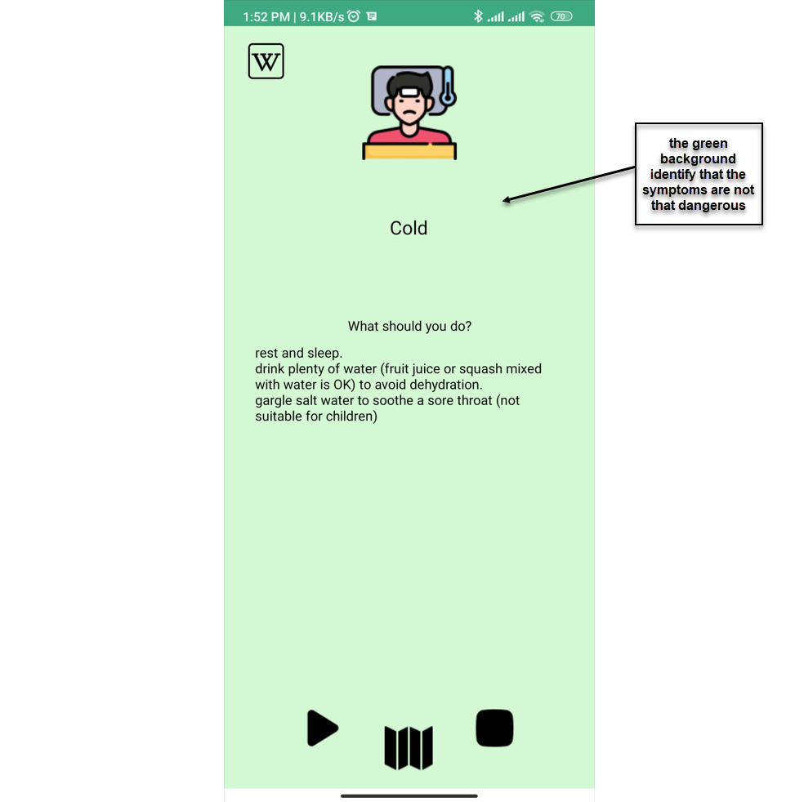
Results Activity

Slide 19
Medics Website:

Slide 20
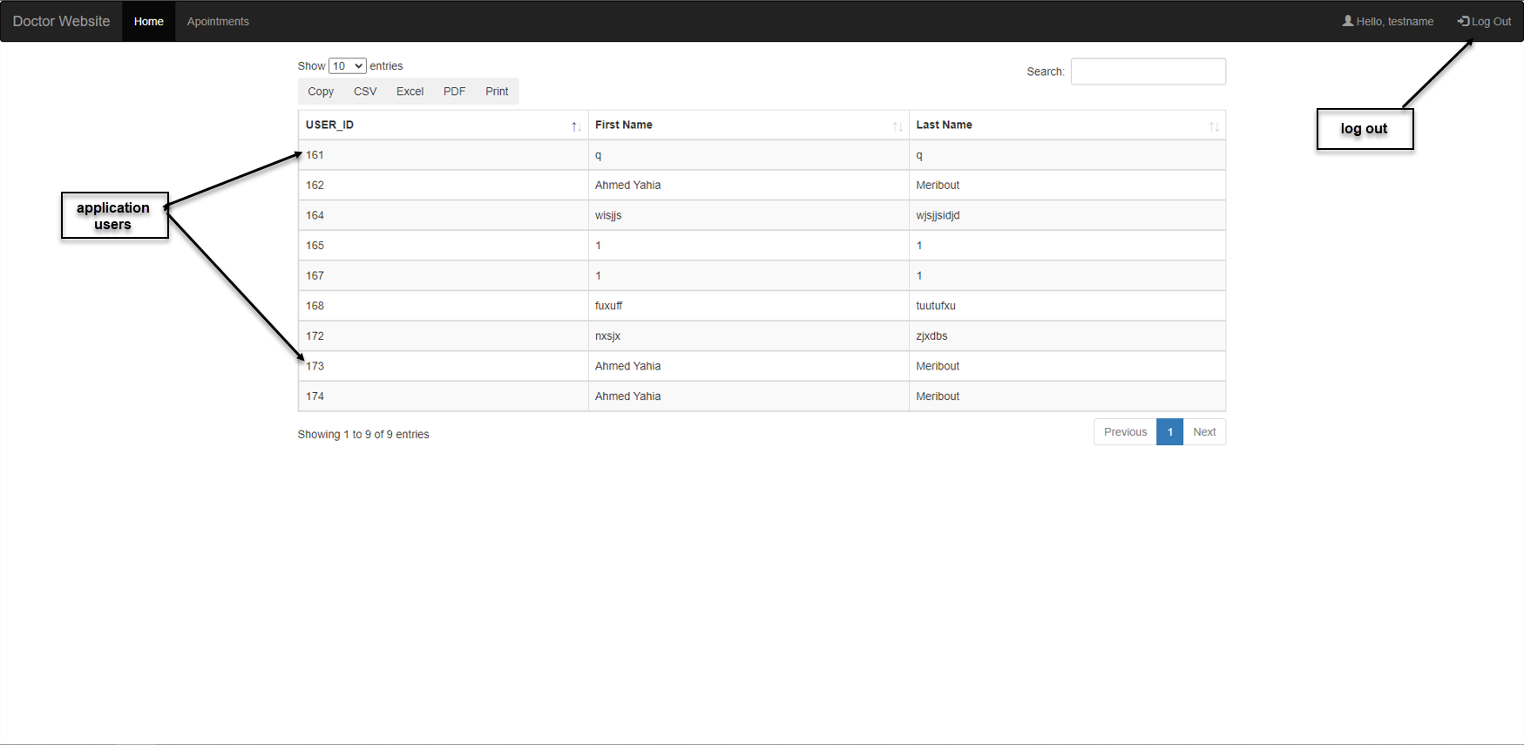
Users interface

Slide 21
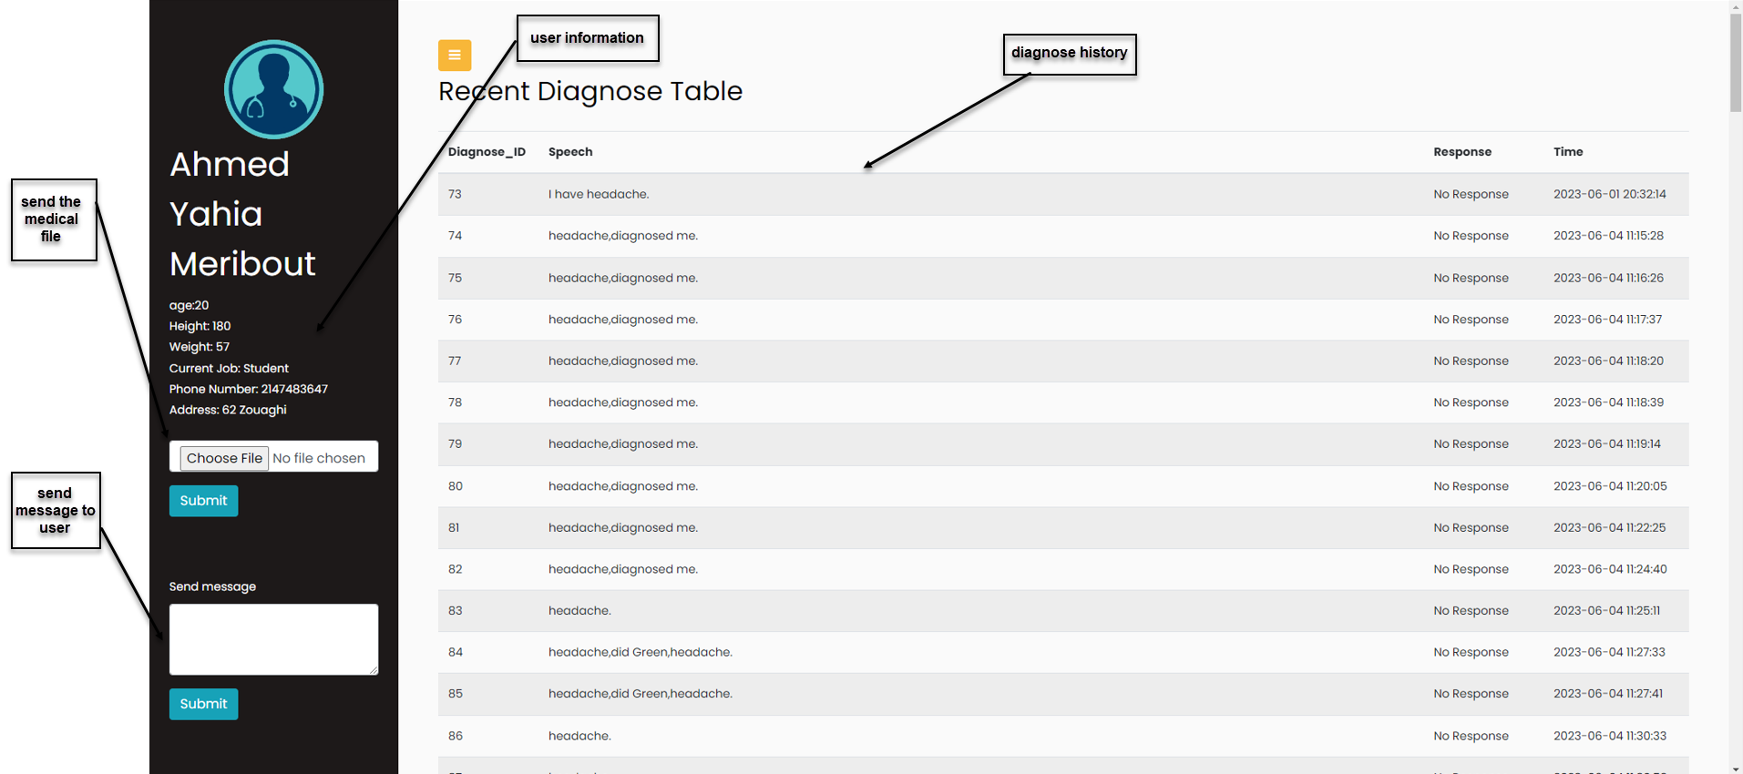
user profile

Slide 22
Conclusion
We have concluded this presentation, the goal of the app is to use technologie to make healthcare accessible to everyone, everywhere, with low costs.

